Slide 1



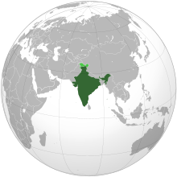


INDIAN CONSTITUTION

Slide 2
Council of Ministers
Two articles - Article 74 and Article 75 of the Indian Constitution deal with the Council of Ministers.
Where article 74 mentions that the council will be headed by the Prime Minister of India and will aid
and advise the President, article 75 mentions the following things:

Slide 3
Council of Ministers
article 75 mentions the following things:
They are appointed by the President on the advice of Prime Minister
They along with the Prime Minister of India form 15% of the total strength of the lower house i.e. Lok Sabha. (The number cannot exceed 15%)
91st Amendment Act provided for the disqualification of the minister when he stands disqualified as a Member of Parliament.
A Minister ceased to exist as one if he is not a member of either house of Parliament for six consecutive months.
Parliament decides the salary and allowances of the council of ministers.

Slide 4
Council of Ministers
Types of Ministers
The Indian Constitution does not categorize ministers into ranks, however, in practice seen in India, ministers are of four types:
1. Cabinet Ministers—He is present and participates in every meeting of the Cabinet.
2. Minister of State with independent charge—He is a Minister of State who does not work under a Cabinet Minister. When any matter concerning his Department is on the agenda of the Cabinet, he is invited to attend the meeting.
3. Minister of State—He is a Minister who does not have independent charge of any Department and works under a Cabinet Minister. The work to such Minister is allotted by his Cabinet Minister.
4. Deputy Minister—He is a Minister who works under a Cabinet Minister or a Minister of State with independent charge. His work is allotted by the Minister under whom he is working

Slide 5
The functions of the Council of Ministers has two major aspects: Policy-making and Implementation.
Policy-making: The Council of Ministers are always the most experienced, the most influential and the most trusted members of the ruling party. As deciding policy matters is a very crucial responsibility, it comes under the Powers of Council of Ministers of India. They decide and frame policies regarding each and every branch of the Government in their meetings. Within the Cabinet room they have every right to differ on policy matters. But once a decision is made, they are expected to speak in one voice. They cannot criticise such a policy in public. That is why this aspect is known as the collective responsibility of the Cabinet.
2. Implementation: Once a policy decision is taken on any subject, it is conveyed to the Minister of State and the Deputy Minister of the concerned Ministry. They chalk out its broad details and hand them over to the civil servants related to that Ministry to translate them into practice. In this way, the business of the Government is managed jointly by the Council of Ministers with the help of the civil servants concerned.

Slide 6

1. All the departments of the Government are under the control of the Ministers and it is their responsibility to run the administration in a good manner.
2. It is the function of the Council of ministers to maintain order and peace in the state.
3. They introduce Bills, participate in the discussion and cast their vote.
4. The budget of the states is prepared by the Council of Ministers.
5. They review the work of planning and the Planning Commission.
6. Managing the foreign tours of the President and other ministers also comes under the functions of the Council of Ministers

Slide 7

The role Council of Ministers can be enumerated as under:
Formulation, execution, evaluation and revision of public policy in various spheres which the party in power seeks to progress and practice.
(2) Coordination among various ministries and other organs of the government which might indulge in conflicts, wastefulness, duplication of functions and empire-building.
(3) Preparation and monitoring of the legislative agenda which translated the policies of the government in action through statutory enactments.
(4) Executive control over administration through appointments, rule-making powers and handling of crises and disasters – natural as well as political.
(5) Financial management through fiscal control and operation of funds like Consolidated Fund and Contingency Funds of India.

Slide 8
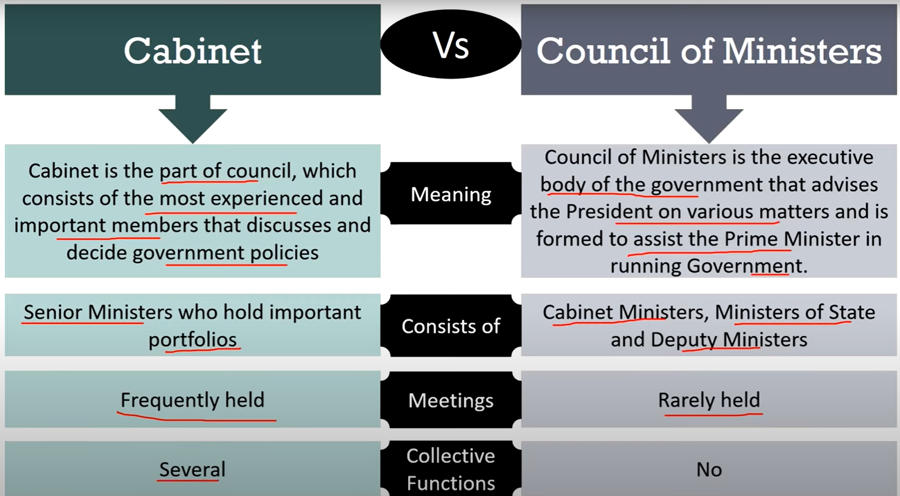

Slide 9
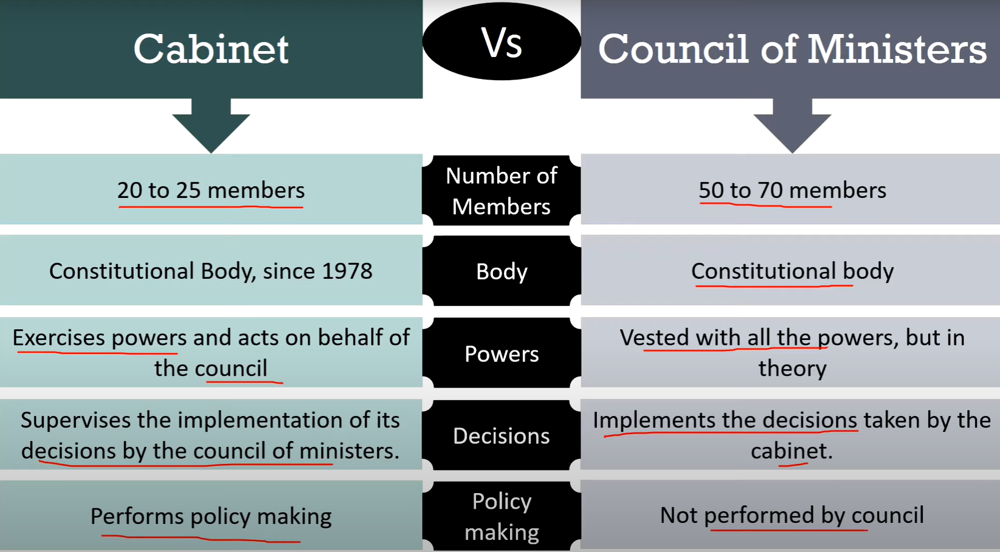

Slide 10
Public, General Administration, Indian Administrative Service, Indian Police Service, Indian Forest Service, Other All India Service, District Revenue Officers, Police, Home, Special Initiatives and Welfare of Differently abled persons.
Minister for Water Resources
Minister for Municipal Administration
Minister for Rural Development
Minister for Higher Education
Minister for Public Works
Minister for Agriculture and Farmer’s Welfare
Minister for Revenue and Disaster Management
Minister for Industries
Minister for Youth Welfare and Sports Development
Minister for Law
Minister for Housing and Urban Development
Minister for Co-operation
Minister for Information & Publicity
Minister for Social Welfare & Women Empowerment
Minister for Fisheries – Fishermen Welfare and Animal Husbandry

Slide 11
Minister for Backward Classes Welfare
Minister for Tourism
Minister for Food and Civil Supplies
Minister for Electricity, Prohibition & Excise
Minister for Handlooms and Textiles
Minister for Health & Family Welfare
Minister for Commercial Taxes and Registration
Minister for Transport
Minister for Hindu Religious and Charitable Endowments
Minister for Finance and Human Resources Management
Minister for Milk & Dairy Development
Minister for School Education
Minister for Environment and Climate Change
Minister for Forests

Slide 12
-THANK YOU-

